Slide 1
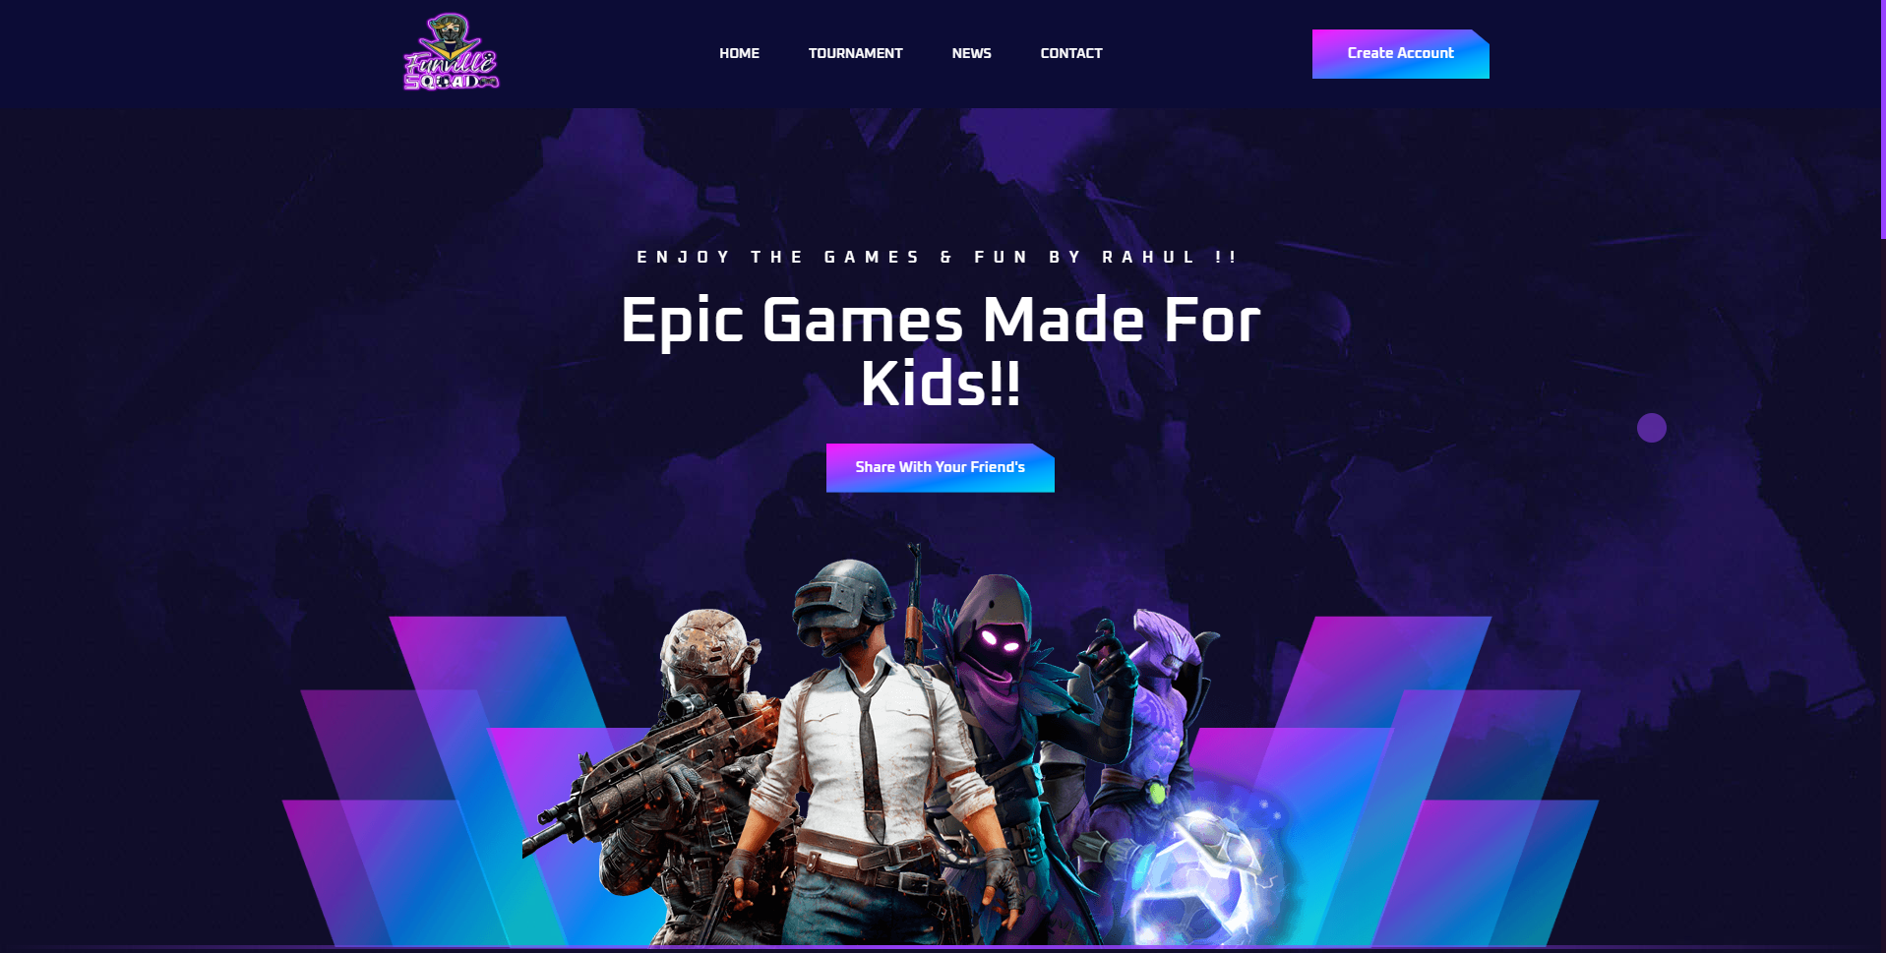
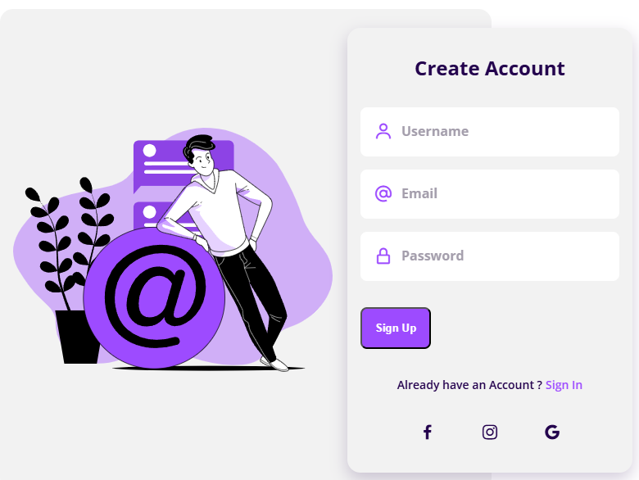
Funville: A Multigaming Platform for Children
Funville is a vibrant and engaging multigaming platform designed to provide children with a safe, educational, and entertaining experience. Featuring a wide range of games, it encourages learning, creativity, and social interaction through play.
Name: Rahul Samanta
I’d: 2213986057
Email: rahul6057.bca22@chitkarauniversity.edu.in
Please Visit My Web Site: https://rahul-funville.vercel.app

Slide 2
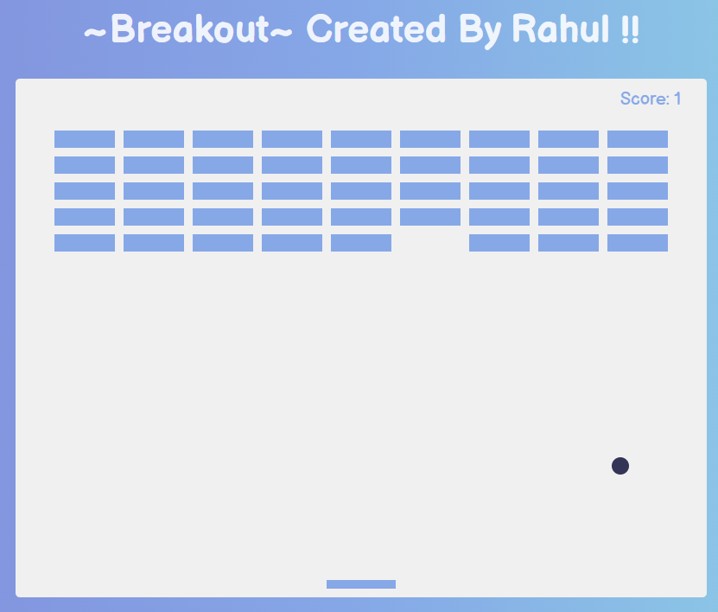

Key Features: Safe, Engaging, and Educational
Safe Environment
Engaging Gameplay
Funville prioritizes child safety with robust parental controls, content moderation, and age-appropriate game selection.
Captivating games, interactive challenges, and a progression-based system keep children entertained and motivated.
Educational Focus
Skill Development
The platform incorporates learning-oriented games that develop cognitive, problem-solving, and social skills.
The platform incorporates learning-
oriented games that develop cognitive, problem-solving, and social skills.

Slide 3
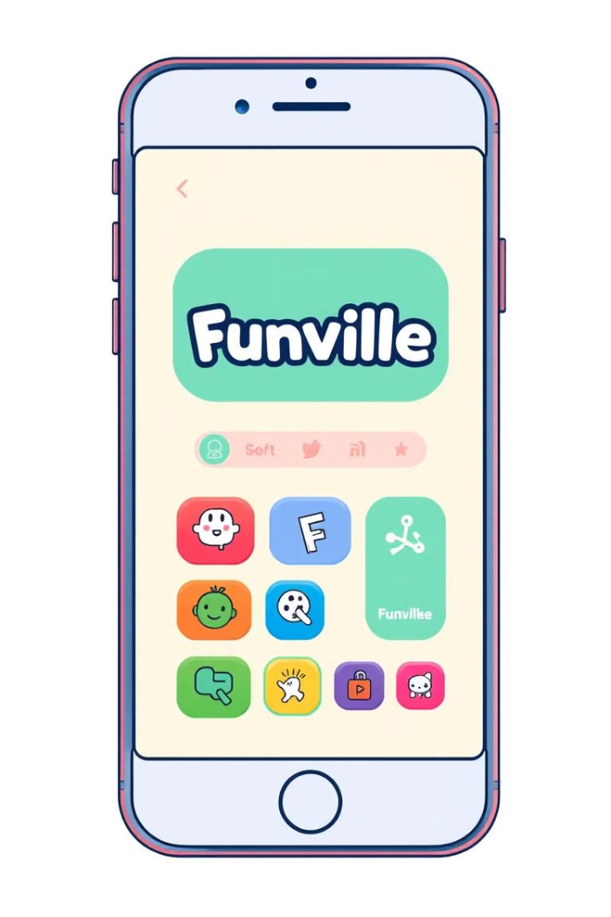





Technology & Design: Responsive, Modern, Interactive
JavaScript, Node.js
HTML, CSS, Bootstrap
Powering the interactive and dynamic features of the platform.
Defining the modern, responsive, and visually appealing user interface.
MongoDB, Render, Mongosh
Design Tools
Storing and managing the platform's data and user information securely.
Figma, Canva, and Adobe Express for creating the engaging visual experience.

Slide 4

User Engagement: Progression, Leaderboards, Multilingual
Progression
Multilingual
Children earn points, unlock levels, and achieve new accomplishments as they play, fostering a sense of growth and mastery.
The platform supports multiple languages, ensuring an inclusive experience for children from diverse backgrounds.
1
2
3
Leaderboards
Friendly competition is encouraged through global and local leaderboards, allowing children to showcase their skills.

Slide 5
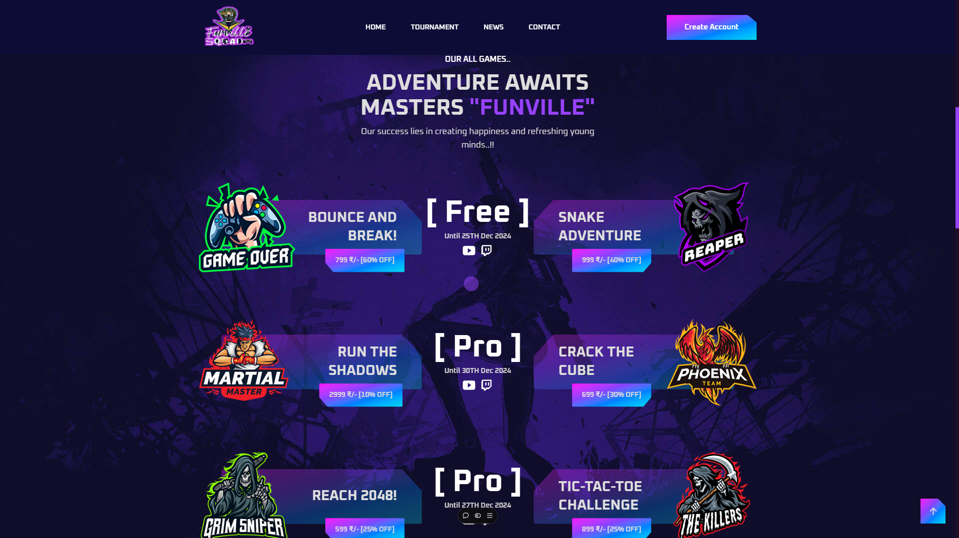


Conclusion: Empowering Children through Play and Learning
Empowerment
Play and Learn
Funville empowers children to explore, discover, and develop their skills through engaging and educational gameplay.
The platform seamlessly integrates learning objectives with fun and immersive gaming experiences, fostering a love of knowledge.
Inclusive Experience
Funville's commitment to safety, diversity, and multilingual support ensures a welcoming and accessible environment for all children.

Slide 6


